Slide 1

Community Provider Brief
Veterans Health Administration
VA Community Care
Georgia Hospital Association
October 26, 2016
Joe Enderle, Director Claims Adjudication and Reimbursement
Rob Morales, Regional Officer, Region 3
David Neumayer, VISN 7 Community Care Manager

Slide 2
Agenda
Transforming VA Community Care
Referral and Authorization
Claims Process
Prescriptions
Emergency Care
Other Health Insurance
Appeals Process
Claims Processing Hot Topics and Updates
Timely Provider Payment
Questions
Appendix

Slide 3
Transforming VA Community Care

Slide 4

Current Community Care Programs Are Confusing
Community Care today is complicated and consists of multiple programs that cause confusion for Veterans, community providers, and VA staff.
To address this issue, VA proposed a plan to Congress. This plan addresses immediate improvements to community care while driving towards the future.

Slide 5
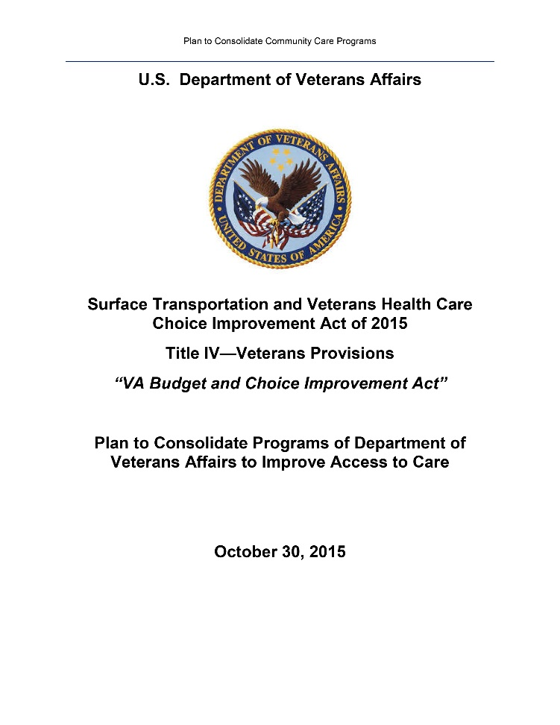




Gathered Feedback from Key Stakeholders
We made sure to incorporate feedback from key stakeholders representing diverse groups and backgrounds to create the plan.
Veterans
VA Staff and Clinicians
Veteran Service Organizations
Community Providers, Federal agencies, and Tribal Health Programs
VA Community Care Plan

Slide 6
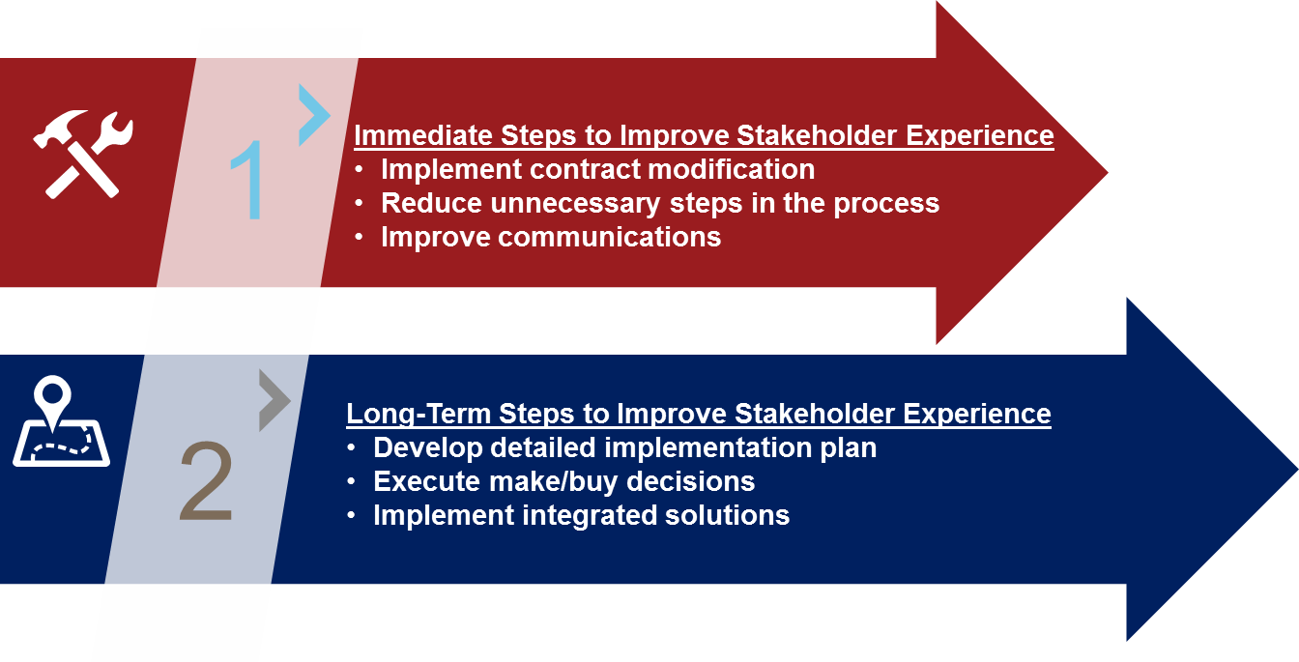
How Will We Get There?
VA is taking immediate steps to improve stakeholders’ experiences while also planning and implementing long-term improvements for the new community care program.
Notes:
QUESTIONS / DISCUSSION

Slide 7
Our Goal for VA Community Care
Deliver a program that is easy to understand, simple to administer, and meets the needs of Veterans, community providers, and VA Staff

Slide 8
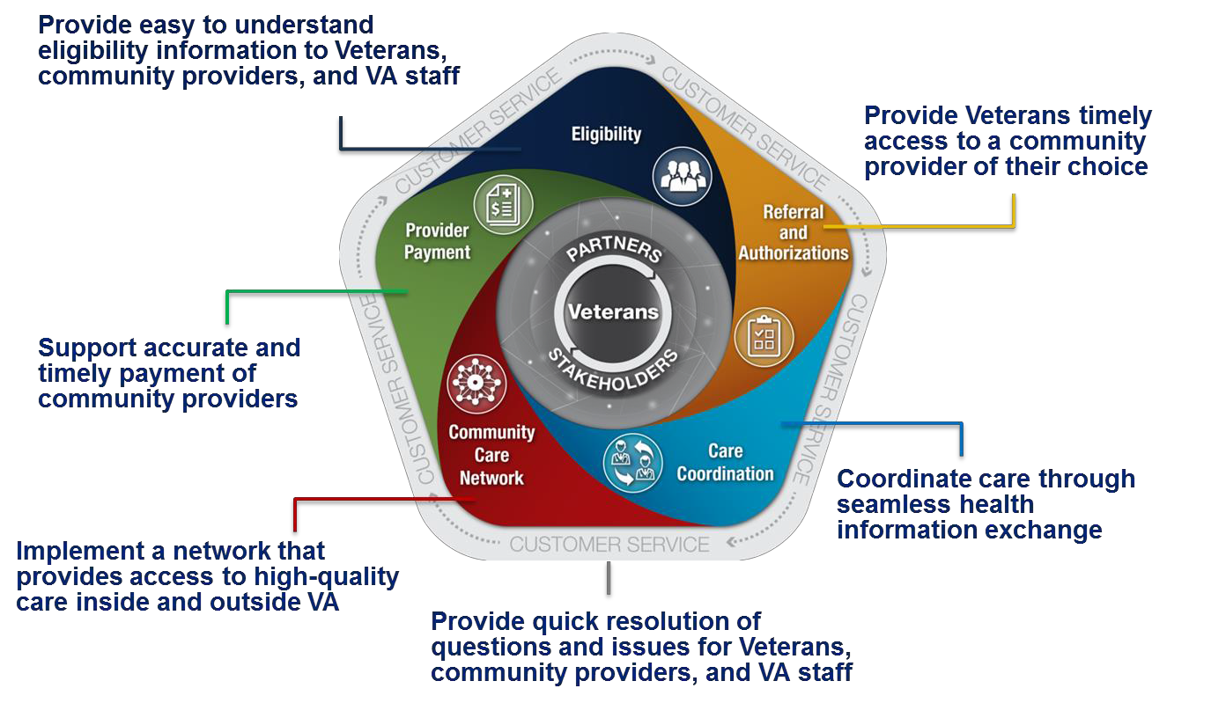
Five Key Components Trace the Veteran Community Care Journey

Slide 9
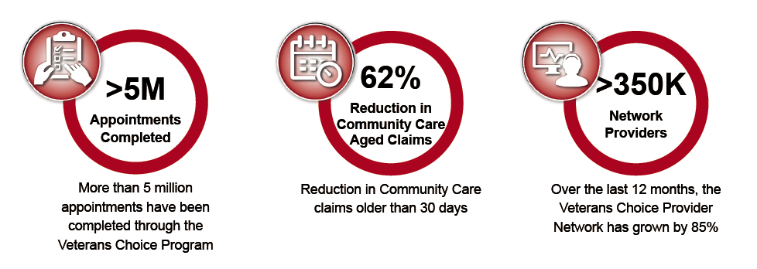
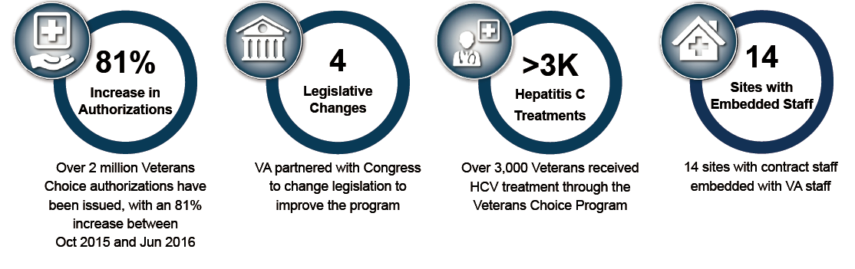
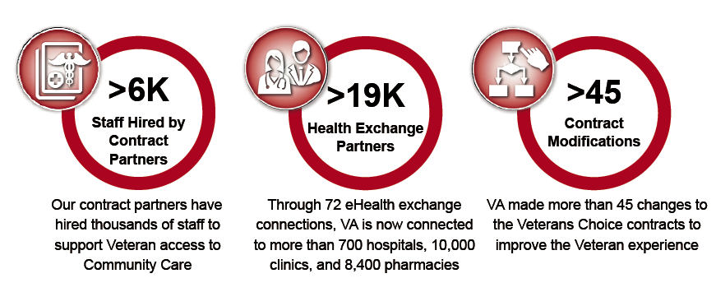
VA is Improving the Veterans Choice Program

Slide 10
Delivering Results for Veterans – Community Care Milestones
Submitted the Plan to Consolidate Community Care Programs
Veterans Access, Choice and Accountability Act of 2014 passed
Increased health claims reimbursement rate from 100% of Medicare to above Medicare in highly rural areas
Changed requirement for distance eligibility
Implemented 40-mile driving distance criteria from a VA medical facility
Removal of enrollment date requirement for VCP
Implemented Unusual or Excessive Burden criteria
Aug
Oct
Dec
Jan
Apr
Sep
Oct
Nov
Dec
2014
2015
Contract modified to implement a nationwide provider network
Increased reimbursement rate for providers in Alaska and Maryland
Implemented Choice Single Booking Innovation (MI)
REFDOC Tool Solution Pilot (GA)
New Orleans VAMC embedded
contractor staff with VA staff
Completed mailing of card letting Veterans know they may be eligible for VCP
Instituted outbound calls from the contractor to the Veteran

Slide 11
Delivering Results for Veterans – Community Care Milestones
Issued draft PWS/RFP for revamped provider network solicitation, held 2nd industry day
Industry Day for Community Care IT Capabilities
Developed VHA Community Care Communications Toolkit
REFDOC Tool Solution pilot (OR, OH, WA, IN, ID)
Implemented modified consult referral from pilot to better clarify requests
Embedded contractor staff with VA staff (MT, ME)
Prior Authorizations Pilot (ND)SC, OR)
2014
Embedded contractor staff with VA staff (TX)
Implemented provider agreements, allowing VA to partner directly with community providers
Prior Authorizations Pilot (OH)
Community Viewer testing with community providers (NY)
REFDOC Tool Solution Pilot (MA,WI)
Jan
Feb
Mar
Apr
May
Jun
Jul
Aug
2016
Created teams to identify and implement improvements to community care
VA decoupled medical records from provider payment reducing administrative burdens
VA Palo Alto partnered with CVS MinuteClinic
Embedded contractor staff with VA staff (NC)
Prior Authorizations Pilot (VT)
Implemented Care Coordination Pilot at Alaska VAMC
Implemented an adverse credit reporting hotline to help Veterans
Increased provider network by allowing additional women’s health providers
Embedded contract staff with VA staff (AZ, NE, FL)
Piloting the REFDOC Tool Solution at additional sites (CA, OR)
Virtual Industry Day for Community Care IT capabilities

Slide 12
Referral and Authorization

Slide 13


Community Care requires prior VA Authorization community care authorizations
Prior to Care
Community Care Visit
VA assesses patient and makes clinical decision.
VA issues authorization based on treatment and service availability.
VA coordinates with contractor to schedule appointment.
Provider provides authorized health care services to Veteran.
Provider submits claim and medical documentation to the contractor for care delivered.

Slide 14
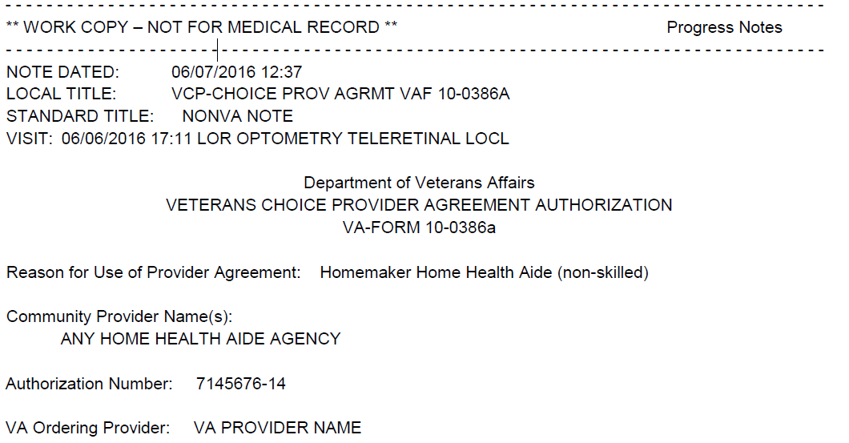
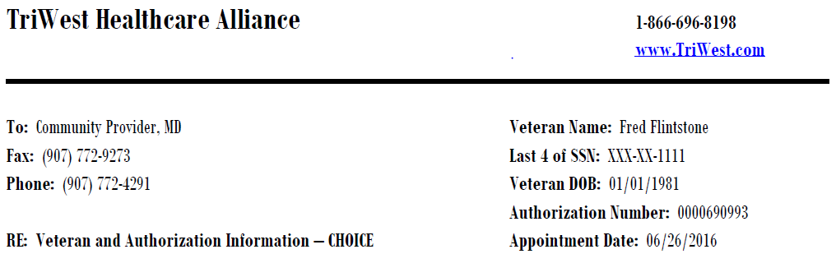
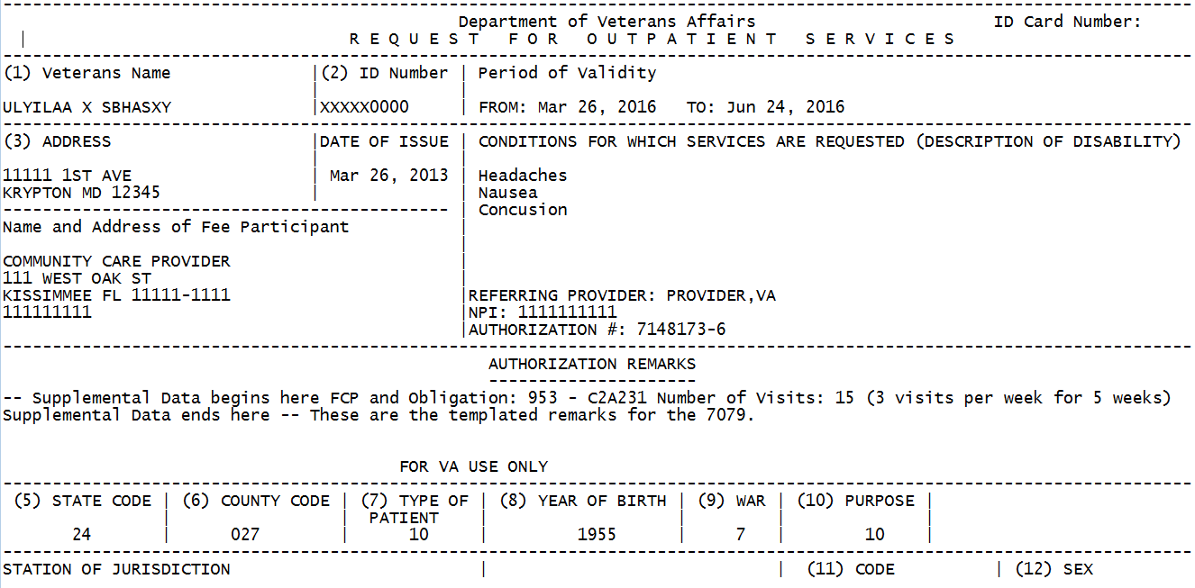
Community Care Authorization Forms
VCP/PC3
VCP Provider Agreement
Traditional VA Community Care
Examples of Prior-Authorization Forms

Slide 15
Claims Process

Slide 16
Electronic Claims Filing
VA encourages electronic health care claims for timely payment.
Providers must use the EDI for which care is authorized.
VCP/PC3
HealthNet Visit http://www.changehealthcare.com/solutions/providers to register with Change Healthcare. Payer Name: Health Net – VA Patient-Centered Community Care. Payer ID: (68021) | TriWest Step 1: Upload medical documentation to provider portal at www.TriWest.com/provider Step 2: Set up an EDI to submit electronic claims by calling Wisconsin Physicians Service (WPS) at 1-800-782-2680 and select Option 2 to register.
VCP Provider Agreements & Traditional Community Care
To register for Change Healthcare’ EDI , visit http://www.emdeon.com/contactform/ or Call 1-877-363-3666 While registering you will need the VA Fee Program payer IDs which include: 12115 for submission of medical claims 12116 for submission of dental claims 00231 for submission of any inquiry transaction

Slide 17
Paper Claims Filing
Claims for VCP and PC3 are routed through contractors by region.
Claims for Traditional VA Community Care and VCP Provider Agreements vary by facility.
Where to Mail a Claim
Health Net Veterans Choice Program – VACAA PO Box 2748 Virginia Beach, VA 23450 Patient-Centered Community Care (PC3) PO Box 9110 Virginia Beach, VA 23452 | TriWest Veterans Choice Program and PC3 WPS-VAPC3 PO Box 981646 El Paso, TX 79998-1646 Note: Must use form CMS 1500 or UB04.
Where to Mail a Claim
Submitting claims electronically may help community providers receive payment faster and reduce administrative costs. If you are unable to file a claim electronically, please complete the appropriate form (original CMS 1500 and/or CMS 1450 (UB-04) and provide the codes for the treatment rendered just as you would when completing a Medicare claim. Contact the facility indicated in the authorization for further instruction on where to mail paper submissions.

Slide 18
For Additional Support, Contact Instructions – VCP and PC3
VA offers multiple resources available such as fact sheets, websites, and hotlines to assist with claims filing.
For Detailed Instructions
Health Net Call 1-866-606-8198 Open 6:00am–7:00pm EST, Monday through Friday, excluding federal holidays OR Visit Health Net claims submission provider page | TriWest Call 1-855-722-2838 Open 8:00am–10:00pm EST, Monday through Friday, excluding federal holidays OR Visit TriWest Claims and Reimbursement Quick Reference Guide
For Detailed Instructions
For information on authorizations, call the number indicated on your authorization letter/form. OR For information on claims payments, visit http://www.va.gov/PURCHASEDCARE/programs/providerinfo/provider_info_claimsPay.asp.

Slide 19
VACC Claims Processing Timeliness
Continue to see tremendous growth in the volume of VACC claims since implementation of Accelerating Access to Care Initiative (ACI)
  Nationally: As of 10/13/16, the National overall performance is currently at 83.51% claims are within 30 days
    Authorized Claims Performance – 85.20% of the inventory is current
    Unauthorized Claims Performance –81.78% of the inventory is current
  VISN 7:
    Overall Performance – 73.44%
    Authorized Claims Performance – 77.74% of the inventory is current
    Unauthorized Claims Performance – 69.61% of the inventory is current

Slide 20
VACC Claims Processing Timeliness
  Atlanta:
    Overall Performance is – 86.11%
    Authorized Claims Performance – 79.35% of the inventory is current
    Unauthorized Claims Performance – 91.02% of the inventory is current
  Augusta:
    Overall Performance – 76.60%
    Authorized Claims Performance – 71.37% of the inventory is current
    Unauthorized Claims Performance – 86.01% of the inventory is current
  Dublin:
    Overall Performance – 79.02%
    Authorized Claims Performance – 80.81% of the inventory is current
    Unauthorized Claims Performance – 76.29% of the inventory is current

Slide 21
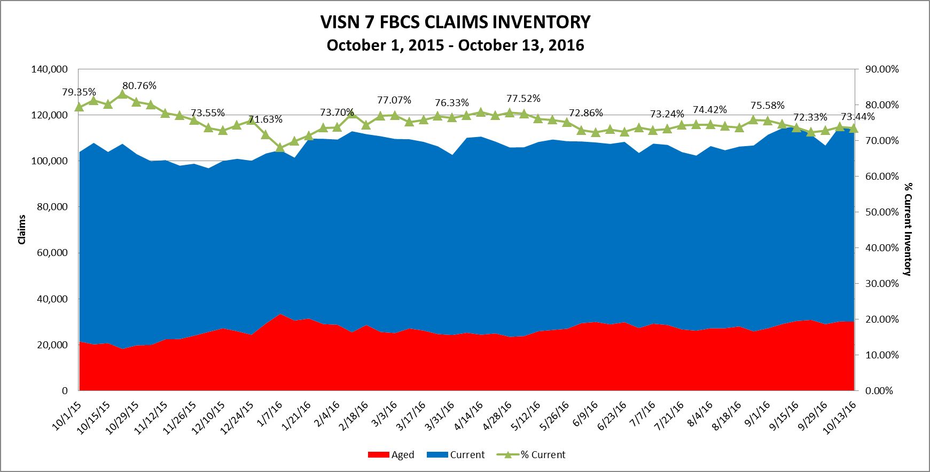
VISN Inventory

Slide 22
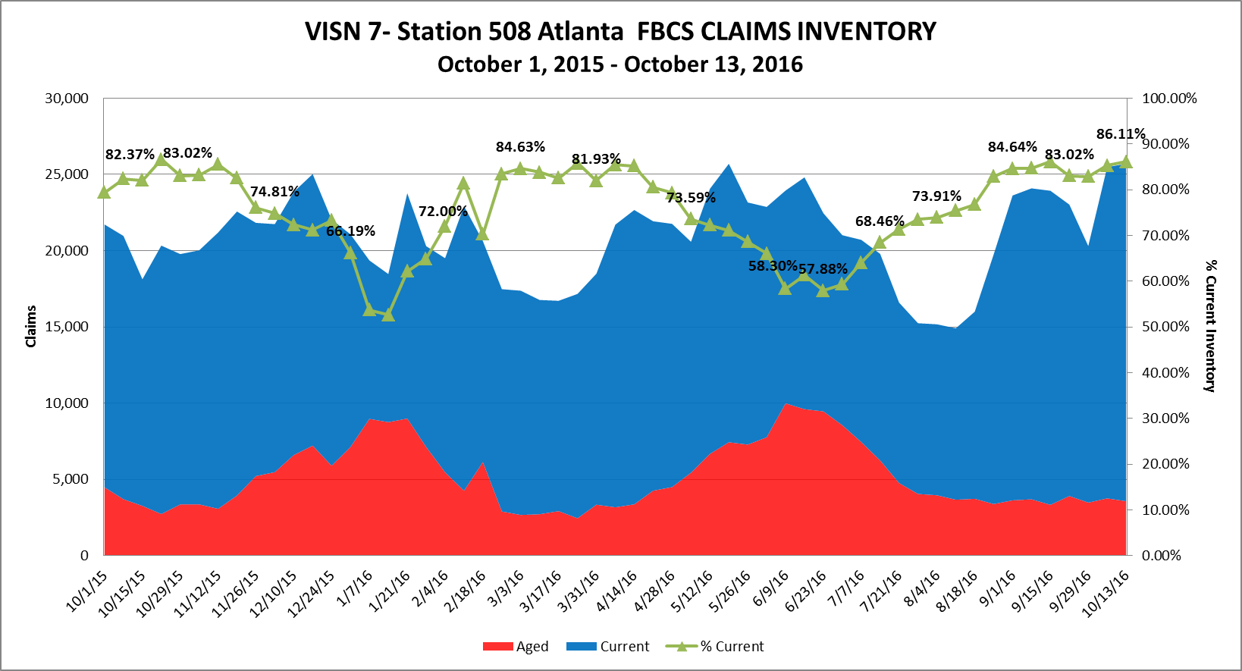
Station Inventory

Slide 23
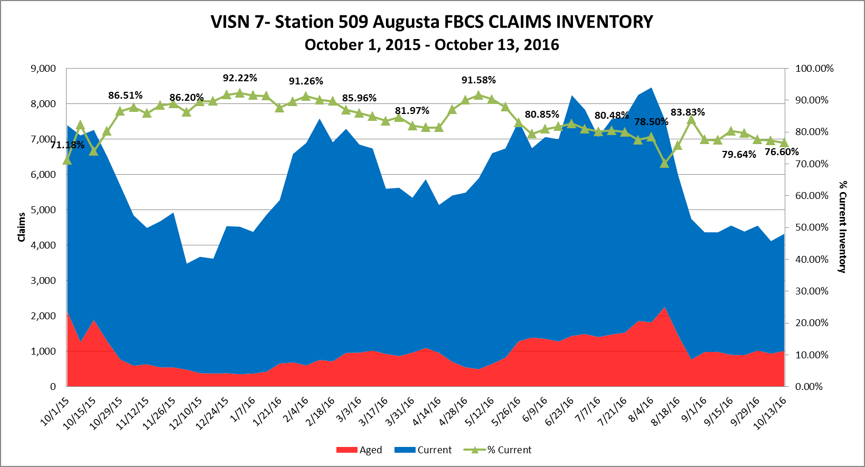
Station Inventory

Slide 24
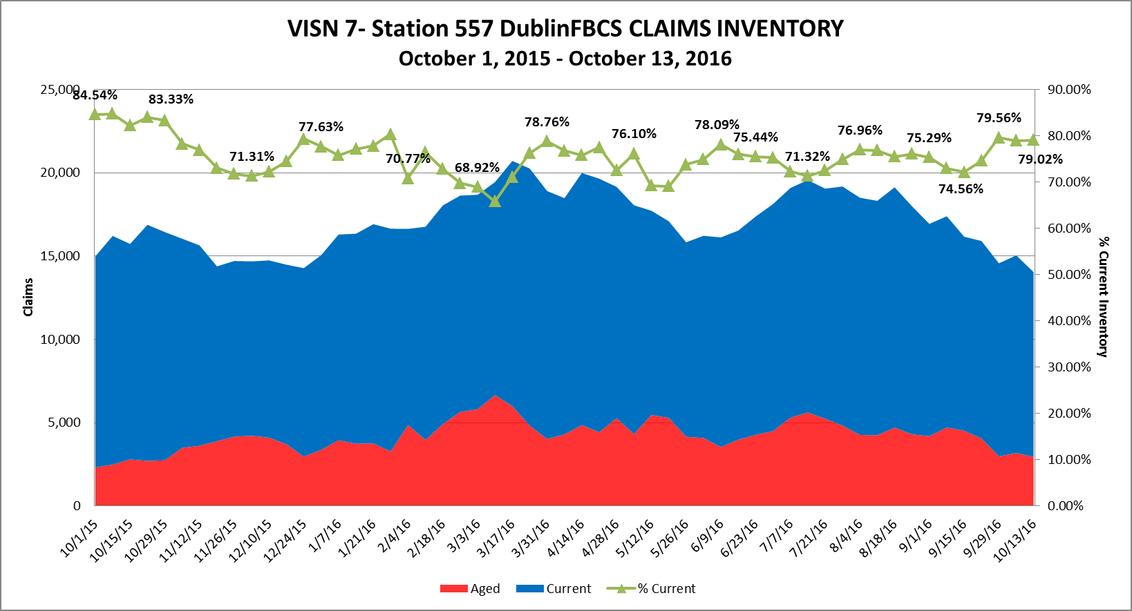
Station Inventory

Slide 25
VACC Claims Processing Timeliness
Update on CBOPC actions taken to improve timeliness:
  Expanded use of overtime
  Added Staffing
  Expedited recruitments
  Increased reliance on external support units and their resources
  Established a “Command Center” and Dashboard to monitor claims status with much more detail
  Increased system functionality to improve automated claims adjudication

Slide 26
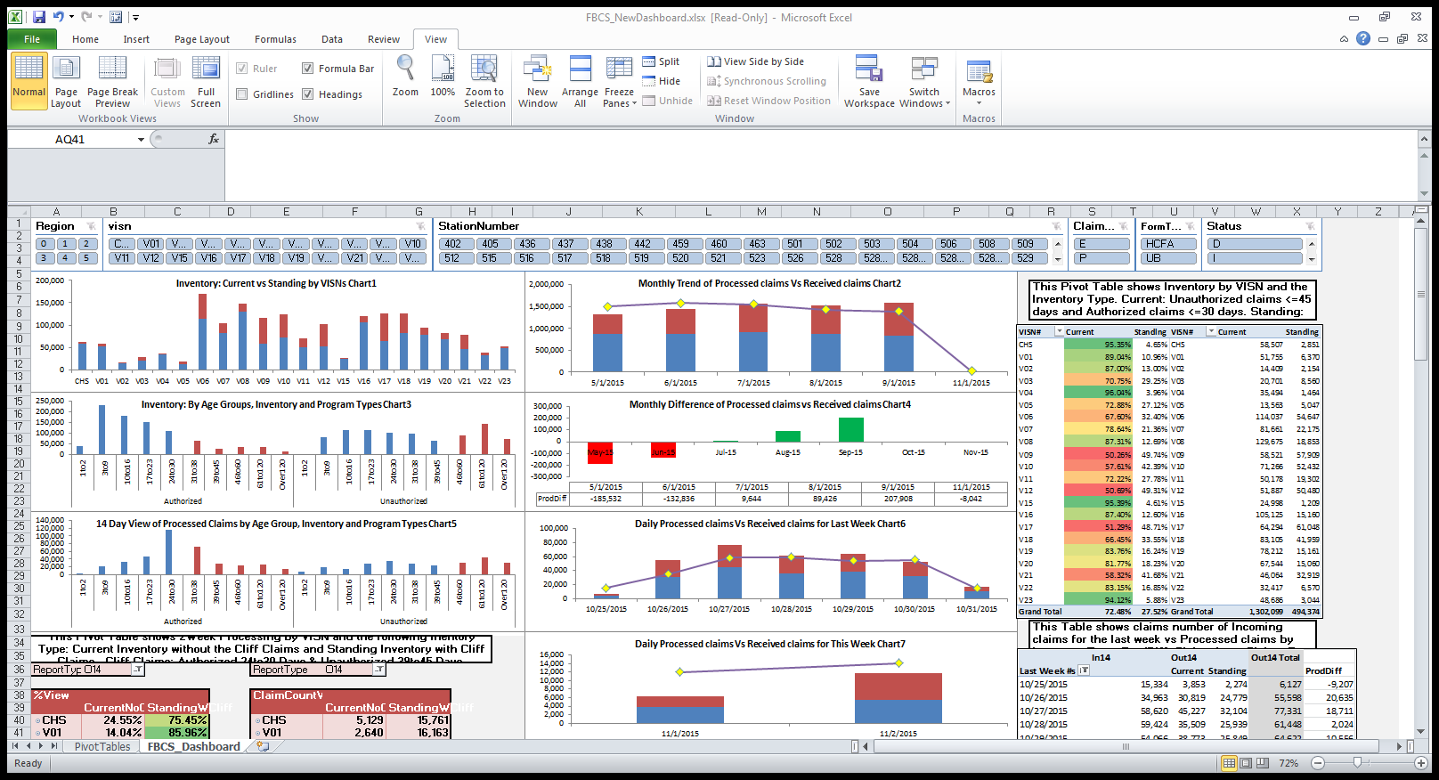
Increased Efficiencies: Command Center

Slide 27
Prescriptions

Slide 28
Prescriptions Written by Non-VA Physicians
Community providers may prescribe medication for authorized care.
Prescriptions must meet the VA Formulary guidelines, which can be found at http://www.pbm.va.gov/NationalFormulary.aspx.
All prescriptions generally must be filled at a VA pharmacy.
VA may reimburse up to a 10-day supply with no refills when medically necessary to start promptly.

Slide 29
Emergency Care

Slide 30
When Emergency Care is Needed
Emergency Care is handled differently than routine care furnished through one of the VA Community Care programs.
5 Key Facts
1
Urgent/emergent hospital admissions should be reported to the nearest VA within 24 hours when possible; notification should not exceed 72 hours.
2
  VA must be notified to facilitate admission to a VA Medical Center or to authorize the transfer to a second non-VA facility if higher care is needed.
3
If the VA has capacity, transfer to VA hospital will be facilitated when the patient is stable to transfer.
4
  If the patient refuses transfer, VA payment will cease and the Veteran will be liable for additional physician and facility charges.
5
  Providers must verify Veteran eligibility for reimbursement of claims and identify the VA of jurisdiction for claims submission.

Slide 31

Payment for Emergency Care
VA only provides payment provisions for preauthorized care for service connected or special authority conditions.
Service Connected Conditions
Non Service Connected Conditions
No provision for payment unless care is preauthorized.
No provision for payment.
Payment is the contracted percent of the Medicare rate or VA Fee Schedule.
Pay lesser of 70% of MPFS or bill amount.
Retroactive authorizations are not allowed.
If no MPFS, then patient pays the amount personally liable.
Pay lesser of: Medicare Physician Fee Schedule (MPFS) rate or bill amount.
If no MPFS, then pay lesser of: VA Fee Schedule or bill amount.
Note: Services provided in Alaska are paid using the Alaska Fee Schedule

Slide 32
Service-Connected Conditions and Special Authority
Service - Connected Conditions
Service-Connected (SC) refers to the Veterans Benefits Administration determination that a illness or injury was incurred in or aggravated by military service.
Non-Service Connected (NSC) refers to conditions not related to military service.
Special Authority Eligibility
Veterans are eligible for cost-free medical care for conditions that have been adjudicated as special treatment authorities related to specific exposures or experiences.
Agent Orange (AO)
Camp Lejeune (CL)
Ionizing Radiation (IR)
Military Sexual Trauma (MST)
Project Shipboard Hazard and Defense (SHAD)
Head and Neck Cancer
Combat Veteran (CV)
Southwest Asia Conditions (SWA)

Slide 33
Payment for Outpatient and Inpatient Emergency Care
Outpatient SC
Acute Inpatient SC
(CMS IPPS Exempt)
Lesser of Medicare rate or billed amount.
If no Medicare rate exists or Medicare exempt, then pay the lesser of Local VA Fee Schedule or billed amount.
Pay VA cost-to-charge rate 48.3%. Generally for Long Term Acute Care authorized under 1703.
Payment is not to exceed billed charges.
Outpatient NSC
Inpatient NSC
Lesser of 70% of Medicare rate or amount patient is liable.
If no Medicare rate exists, then patient pays the amount liable.
Pay Lesser of: 70% of Medicare rate or amount patient is personally liable.
Notes:
Acute inpatient SC authorized under 1703 based on Medicare rates. Cost to charge @ 48.3% is generally reserved for Long Term Acute Care (LTAC)

Slide 34
Other Health Insurance (OHI)

Slide 35
What is OHI?
Other health insurance (OHI) is coverage through Veteran or Veteran's spouse provided by employer, Veteran or other non-federal source.
VA is required to bill OHI for medical care, supplies, and prescriptions provided for treatment of Veterans’ NSC conditions.
VA cannot bill Medicare, but can bill Medicare supplemental health insurance for covered services.
Typical OHI Sources
  Private Insurance
  Commercial policies
  Public Insurance
  Medicare
  Medicaid
  Government Plans
  TRICARE
  CHAMPVA
Notes:
Health insurance is a contract between a policyholder and a third party payer or government program to reimburse all or a portion of the cost of medically necessary treatment or preventive care on the basis of the contract purchased. This insurance contract is also known as a policy.
Most private insurance companies have policies which include coverage for hospital care, surgical fees, and physicians’ services. In addition to these benefits, many plans offer catastrophic health insurance coverage, preventive care, dental insurance, disability income insurance, long-term care and home health care insurance.
Each patient may have a different type of health insurance policy with various benefits. Patients may be covered under individual policies or have several plans and be insured under different types of private, state, or federal programs.

Slide 36
Appeals

Slide 37

When a Provider Disagrees with a Denial Coverage
  Appeals can be initiated by the provider, Veteran, legal guardian on the Veteran’s behalf, or a representative appointed in writing by the Veteran or provider.
Reconsideration Request Requirements
  Be submitted to the site which made the original determination.
  Be submitted in writing within one year of the date of the initial determination.
  Identify why there is reason to believe the denial decision was made in error.
  Include new and relevant information not previously submitted.
  VA Response
  After review, VA staff will issue a letter advising of the decision. If upheld, the reconsideration will become a formal appeal.

Slide 38
Claims Processing Hot Topics and Updates

Slide 39
Hot Topics
Receipt/mailing of Preliminary Fee Remittance Advice Reports (PFRARs)
Standard processes and expectations remain in place to include daily receipt, scanning, and mailing of correspondence.
Emergency system patch is currently in testing to increase PFRAR generation, tracking, and delivery.
Processing of claims prior to records being scanned and indexed
  Implementation of a 14 day hold policy (1725/1728) and queue micromanagement to prevent premature adjudication.
Rejecting claims
  Increased auditing established to detect and review adjudication decisions of all claims processors.
EDI 45 day hold
  Extending to a 90 day hold – Patch release scheduled for July 2016.
Prompt Pay Act (PPA)
  October 2015: all preauthorized VACC, including individual authorizations, is subject to the PPA with the exception of intergovernmental and provider agreements.

Slide 40
Timely Provider Payment

Slide 41

Prompt Payment Act
The Prompt Payment Act (5 CFR Part 1315) makes sure that valid and proper invoices submitted by vendors are paid on time by federal agencies.

Slide 42

Automate and Improve Provider Payments
What we want to hear from Veterans: “I understand my financial responsibility and I am billed accurately by VA.”
What we want to hear from providers: “It is easy to work with VA. They have adopted industry standards, pay promptly, and are a good partner.”
We are working to enable accurate and timely payments to our community partners.

Slide 43

Removing Administrative Burdens for Providers
VA executed more than 45 contract modifications to eliminate delays in payment.
VA separated submission of medical documentation from provider payment.
VA streamlined required medical documentation to reduce administrative burden.
VA enhanced real-time monitoring of claims status using new tools.

Slide 44
Appendix

Slide 45
Claims Processing Point of Contacts
For additional questions, the following contacts can respond to your questions.
Joe Enderle, Director, VACC, Claims Adjudication and Reimbursement
(303) 370-5088
Joseph.Enderle@va.gov
Cindy Heaton, Deputy Director, Claims Adjudication and Reimbursement
(406) 461-5971
Cindy.Heaton@va.gov
Roberto Morales, VACC Regional Officer – Region 2
(727) 575-8120
Roberto.Morales2@va.gov
David Neumayer, VACC V7 Manager
(843) 789-7831
David.Neumayer@va.gov
Provider Relations Email: Provider.Response@va.gov

Slide 46
Additional Resources
Chief Business Office Purchased Care (CBOPC) Website: http://www.va.gov/purchasedcare/
  For community provider fact sheets and guidebooks.
Veterans Choice Program Website: http://www.va.gov/opa/choiceact/
  For more information on how to become a Choice Program and/or Patient-Centered Community Care (PC3) provider.

Slide 47
Emergency Services and PFRAR

Slide 48
Claims Requirements for Emergency Care
Minimum Requirements
1
Community hospital must notify nearest VA health care facility within 72 hours of an urgent/emergent hospital admissions.
2
  Community hospital must provide relevant documentation so VA can determine its payable amount based on each Veteran’s specific circumstances and eligibility.
Claims and Emergency Report Must Contain
Patient name, ID, demographics
Hospital ID, name, address
Hospital point of contact
Provider name and NPI
Patient chief complaint
Clinical presentation of patient
Stabilization for transfer
Care coordination information
3
  VA will generate a Preliminary Fee Remittance Advice Report (PFRAR) supplying claims data and reasons for disapproval and/or payment amounts.
4
  Veterans will receive a claims letter for emergency care received.
Please visit www.va.gov/directory to find the nearest VA health care facility

Slide 49
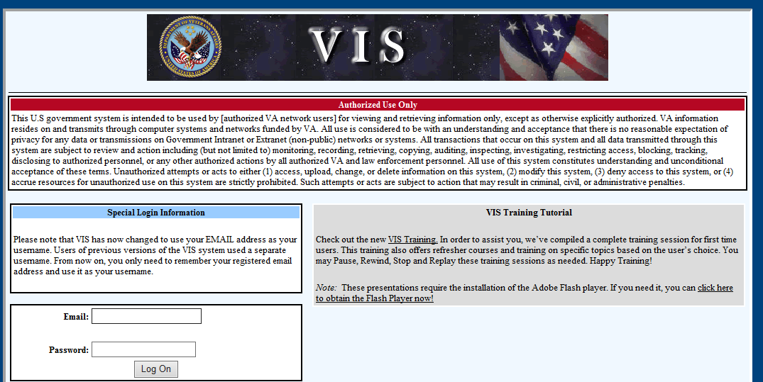
Preliminary Fee Remittance Advice Report (PFRAR)
A PFRAR provides claim data, payment amounts, and reasons for disapproval. It generates automatically during the payment process. Providers should receive PFRARs within one week of a claim being processed.
Note: If you have not received a PFRAR, please follow-up with your Billing or Collections department first before contacting the local VA health care facility.
Provider Resource
Vendor Inquiry System (VIS)
Provides access to VA Treasury payment info.
Special log-on access is required.
To register at, visit https://www.vis.fsc.va.gov/.

Slide 50
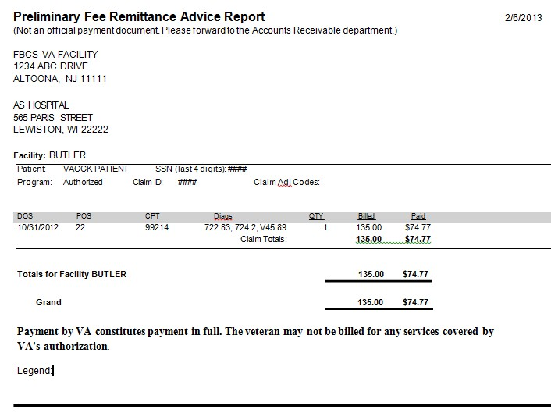
How to Read Preliminary Fee Remittance Advice Report – CMS-1500
VA facility that processed the claim. All claims and questions should be directed to this location.
[originating VA Facility]
Information on file for your office. Please make sure this information is correct and current.
[claimant / vendor]
Patient identification information.
Claim information.
Total to be paid by VA for claims listed on this PFRAR.
Explanation of claim adjustment codes
used by VA that are particular to this claim.

Slide 51
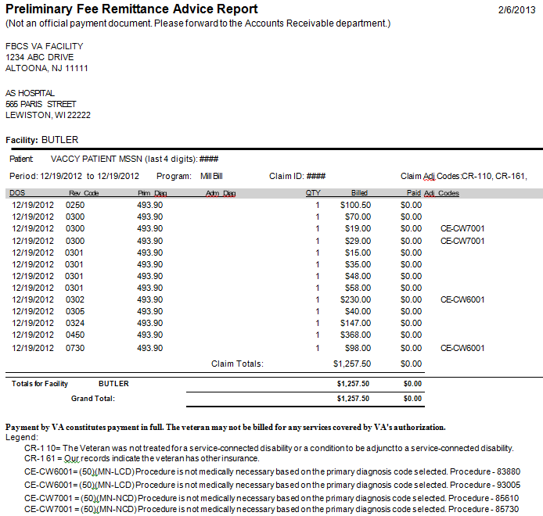
How to Read Preliminary Fee Remittance Advice Report – UB04
VA facility that processed the claim. All claims and questions should be directed to this location.
[originating VA Facility]
Information on file for your office. Please make sure this information is correct and current.
[claimant / vendor]
Patient identification information.
Claim information.
Claim adjustment codes.
Total to be paid by VA for claims listed on this PFRAR.
Explanation of claim adjustment codes used
by VA that are particular to this claim.

Slide 52
Other Health Insurance (OHI) and Service Connected and Special Authority

Slide 53
Billable vs. Non-Billable OHI for VCP
Most types of private insurance are billable for VCP, while public insurance and government plans are generally considered non-billable.
COB – Coordination of Benefits
Primary Insurance | Secondary Insurance | Considered Billable
care | Commercial policy or Medigap | No – VA Primary payer
Commercial Policy | Medicare | Yes – OHI primary payer
Spouse’s Commercial Policy | Medicare | Yes – OHI primary payer
Medicare Advantage | n/a | No – VA Primary payer
HMO | n/a | Yes – VA Primary payer
Special Class | n/a | Conditional
TRICARE | n/a | No
Regional Counsel | n/a | No– VA Primary payer
Medicaid | n/a | No– VA Primary payer
Pharmacy | n/a | No– VA Primary payer
Mental Health | n/a | Conditional
To determine if a Veteran’s OHI is billable, VA conducts an assessment to review the various OHI policies that may be active.
Notes:
These types of insurance are considered non-billable for the Choice Program
Medicare
Medicare Advantage or Medicare HMO (these are Medicare replacement policies)
If the patient has Medicare and a Medicare Supplement policy, such as a Medigap or a Medicare Secondary plan
TRICARE
Regional Counsel (Workers Comp or Tort cases)
Medicaid
Pharmacy policy (scripts are filled by the VA Medical Center)

Slide 54
Service Connection & Special Authority Screening
Veterans are eligible for cost-free medical care for conditions that have been adjudicated as a SC condition or for special treatment authorities related to exposures or experiences.
SC/SA screening determines the primary payer for VA Community Care Programs.
SC/SA Monitors
Primary Payer
Congress
Office of Management and Budget
Office of the Inspector General
VHA Leadership
Third Party Payers
Veterans
Coordination of Benefits (COB) & Primary Payer
Veteran has SC/SA condition | Treatment for SC/SA Condition | Primary Payer
Yes | Yes | VA
Yes | No | OHI*
* If Veteran has Other Health Insurance (OHI)

Slide 55
Frequently Asked OHI and SC/SA Questions
Question | Answer
If a patient is 100% service connected for a specific condition, are all their encounters service-connected? | No. The percentage (%) of service connection pertains only to the rated condition. If the treatment was for a non-service connected condition, it would NOT be considered a service-connected encounter. If a patient is 0% or 100%, they are still rated for that specific condition. In other words, if a patient is 100% SC for his/her knee and he is treated for his back, this visit is billable.
Are encounters screened as AO, EC, MST, CV, etc. billable? | No. Treatment for conditions covered under SAs are not billable. Encounters are screened to ensure referral for treatment meets special authority intent.
Must the Veteran’s other health insurance (OHI) be billed for conditions that are adjunct or secondary to the service-connected condition? | Yes. Adjunct and secondary conditions are not service connected per current interpretation of the law and should be billed to the insurance carrier. Current interpretation of the law is as follows: Adjunct condition is associated with or aggravating a disease or condition which is service connected. Secondary condition has been caused or is the result of a service connected condition.

