Slide 1
Veterans Choice Program
Provider Orientation
October 2016

Slide 2

Introduction
The Patient-Centered Community Care (PCCC) program provides eligible Veterans access to care through a comprehensive network of community-based providers when the U.S. Department of Veterans Affairs (VA) cannot provide care in their own facilities.
The program augments VA’s ability to provide specialty inpatient and outpatient health care services to VA enrolled Veterans.
Health Net Federal Services, LLC (HNFS) expanded its services with VA in support of the Veterans Access, Choice and Accountability Act of 2014 (VACAA), which funded Veterans Choice Program (VCP). VCP allows eligible Veterans who live more than 40 miles from a VA health care facility or are unable to get a VA appointment within 30 days of their preferred date, or within 30 days of the date determined medically necessary by their physician, to obtain approved care in their community.

Slide 3
Proud to Support VA
Health Net Federal Services, LLC (HNFS) supports VA in Regions 1, 2 and 4. These three regions cover 13 VISNs,
and encompass all or portions of 37 states.
Plus the District of Columbia, Puerto Rico and the U.S. Virgin Islands.

Slide 4
Health Net Federal Services and Veterans Choice Program
Health Net Federal Services has more than 3,000 employees and regional call centers in eight states who are solely dedicated to serving Veterans and providers through the VCP.
Since VCP was implemented, HNFS has answered more than 3 million phone calls from Veterans, providers and VA staff to help coordinate Veteran care.
  Our current call volume is more than 300,000 calls monthly, up from 27,000 in November 2014.
Health Net Federal Services has contracted or registered with more than 416,000 health care providers nationwide.

Slide 5
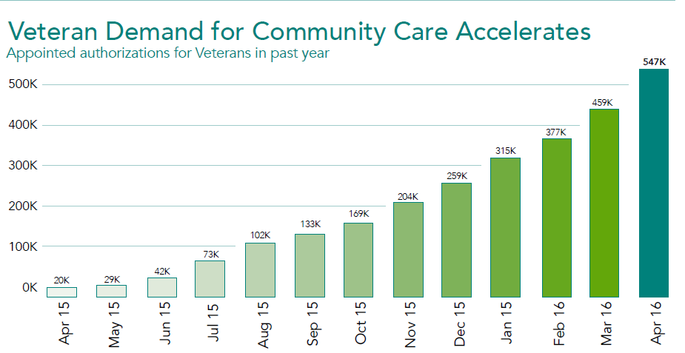
Authorizations
Since Veterans Choice was implemented, HNFS has secured more than 546,000 medical appointments for Veterans in their communities.*
*as of May 3, 2016

Slide 6
Options for Providers
In order to treat Veterans under PCCC or VCP, providers must join the HNFS PCCC provider network or register as a VCP participating provider. Here’s a chart to help illustrate some of the differences between the two options.
PCCC Network | VCP Participation
Provider signs an HNFS network contract and completes the credentialing process. Provider is listed in our Preferred Provider Network for all current and future VA programs. Provider has access to approximately 5.2 million Veterans eligible to receive care under the PCCC program, including Veterans eligible for the Veterans Choice Program. Providers are considered the first option in our internal referral and authorization system. | Provider agrees to Veterans Choice Program Terms of Participation (online). Certification is complete when VCP-eligible Veterans select the provider for authorized care. Provider can only render services to VCP-eligible Veterans upon receipt of an authorization.

Slide 7
Veterans Choice – Provider Participation
Participating providers agree to comply with all HNFS and VA program rules, policies and procedures.
These documents are available on the HNFS website, www.hnfs.com/go/VA.
Rendering providers must:
  be Medicare participating (certain exceptions apply),
  have an active unrestricted state license,
  be DEA licensed (as applicable),
  have no sanctions, and
  provide a Type 1 and/or Type 2 NPI (as applicable).
.

Slide 8
Veterans Choice Program Process
VA determines the Veteran’s eligibility for the program.
  Eligibility for VA health care is based on Veteran status, service-connected disabilities, or exposures, income and other factors.
  When the Veteran’s local VA health care facility indicates a Veteran is eligible to receive care in the community, HNFS processes the authorization request from VA and coordinates with the Veteran to assign a provider for care.
Health Net Federal Services sets an appointment with an approved community provider and notifies the Veteran.
  All initial care under VCP requires prior authorization and, unless otherwise indicated, covers services related to the evaluation and treatment for the episode of care.
Health Net Federal Services pays the provider after a submitted claim is verified for eligibility and authorized services.
Health Net Federal Services invoices VA after issuing the claims payment to the provider.

Slide 9
Appointments
Health Net Federal Services is responsible for coordinating initial appointments with a provider’s office or facility. Providers are strongly encouraged to contact Veterans with a courtesy appointment reminder.
Providers must notify HNFS of no-show, missed, canceled, or rescheduled appointments.
  You may notify HNFS telephonically at 1-800-979-9620 for PCCC authorizations or 1-866-606-8198 for VCP authorizations. Please have the Veteran’s name, date of birth and authorization number available when you call.
  On the day after the Veteran’s initial scheduled appointment, providers will receive a fax from HNFS requesting confirmation that the Veteran kept their appointment.
  Providers may not bill the Veteran, VA or HNFS for no-show, canceled or rescheduled appointments.

Slide 10

Provider Notification Packets
Once an appointment is scheduled, HNFS will send the following to the provider:
cover sheet followed by a copy of the authorization
provider notification packet
The Provider Notification Packet includes Veteran contact information, authorized services, instructions for returning medical documentation, and claims information.
Note: It is important the Provider Notification Packet be distributed to the appropriate department(s).

Slide 11
Request for Additional Services – Veterans Choice Program
Under Veterans Choice, additional prior authorization from HNFS is required when the Veteran:
requires care beyond the approved dates;
requires care beyond the number of visits/units authorized;
needs care for another medical condition or body part (including other joints); and/or
requires an inpatient admission.
Providers also must request additional authorization for the following:
services specifically excluded from the authorization
urgent consultations required as a result of a newly-identified critical finding (such as cancer)
Note: Do not use the bar-coded fax cover page when submitting an RFAS form. The bar-coded fax cover page is for the submission of medical records only.

Slide 12
Referring Veterans to Other Providers
Please refer to program-specific guidelines when referring Veterans for authorized care you are unable to perform at your practice, as not all services require a new authorization/Request for Additional Services.
Veterans with PCCC-authorized care must seek care from network providers. Veterans with VCP-authorized care may use network providers or providers not in our network who have agreed to VCP participation terms and are eligible to render services under VCP.
When referring Veterans for diagnostic services, please use our online Ancillary Provider Search to locate a provider. If you are unable to locate a provider in our ancillary directory, please contact HNFS for assistance.

Slide 13

Referring Veterans to Other Providers continued
Please share the authorization details provided in your provider notification packet with all providers involved in the Veterans care, as this will expedite claims processing.

Slide 14
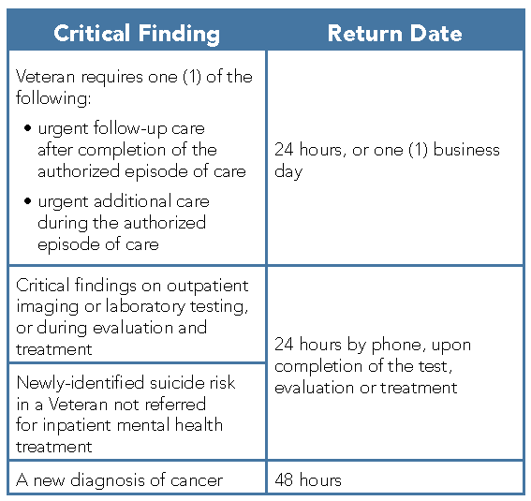
Reporting Critical Findings
VA defines critical findings as a test result value or interpretation that, if left untreated, could be life threatening or place the Veteran at serious health risk.
Critical values/results are those results from laboratory, cardiology, radiology departments, and other diagnostic areas that, upon analysis, are determined to be critical, regardless of the ordering priority.

Slide 15
Critical Findings continued
Remember to document the VA notification in the Veteran’s medical records. Refer to the Provider Notification Packet for contact information to the authorizing VA health care facility.
Providers must also report critical findings to HNFS by calling
  1-800-979-9620 for PCCC authorizations or
  1-866-606-8198 for VCP authorizations.

Slide 16
Prescription Medications
Prescription medications must be prescribed in accordance with the VA National Formulary (VANF).
Routine prescriptions
VA requires Veterans fill all routine (non-urgent/non-emergent) prescriptions at VA pharmacies. Veterans who fill routine prescriptions elsewhere may not be reimbursed. Please advise your Veteran patients accordingly to help them avoid unexpected expenses.
Fax the prescription to the local VA pharmacy or
Give Veteran a copy of the HNFS authorization to physically take or mail along with the prescription to a local VA pharmacy for fulfillment.
Urgent prescriptions
Providers may issue Veterans with up to a 14-day supply of VANF prescriptions when needed urgently.
Veterans may take urgent prescriptions to any non-VA pharmacy to be filled at his/her own expense and seek reimbursement from the Purchased Care office at their local VA health care facility.

Slide 17
Provider Claims and Reimbursement
All services require a prior authorization from HNFS to prevent claims denials. No payment will be made to a provider for services rendered to Veterans that are not authorized by VA and HNFS.
Claims must be submitted within 30 days after services have been rendered.
Medical documentation must be submitted to HNFS to avoid recoupment efforts.
  Inpatient care: Submit medical documentation within 25 days of discharge (include a discharge summary).
  Outpatient care: Submit initial medical documentation within 60 days of the first appointment. Submit final medical documentation, which summarizes the results of medical care provided, within 60 days after completion of the episode of care.

Slide 18
Medical Documentation
Medical documentation must be faxed to HNFS at 1-855-300-1705 within the time frame specified in the provider packet.
For PCCC claims only – Medical documentation is required before HNFS can issue claims payment.
Tips:
Use the unique bar code cover sheet provided (one for each authorization) when returning medical documentation. (Note: Health Net Federal Services will soon offer a generic fax cover sheet at www.hnfs.com/go/forms that may be used.)
Do not combine documentation for multiple authorizations.
Do not submit claims with medical documentation, as we cannot accept faxed or black and white claims for processing.
An electronic or written signature is required to be considered complete.
Review the Required Medical Documentation Content checklist, available at www.hnfs.com/go/forms.

Slide 19
Clean Claims
All claims must be submitted to HNFS, and not to VA or Medicare.
A clean claim is a claim that complies with billing guidelines and requirements, has no defects or improprieties, includes substantiating medical documentation (PCCC only), and does not require special processing that would prevent timely payment.
  Clean claims will be processed within 30 days, and providers will receive their payments from HNFS.
  Claims for VCP authorized services must be submitted within 120 days, regardless of other health insurance (OHI) claim processing times.

Slide 20
Other Health Insurance – VCP Authorizations Only
The authorization will indicate if the Veteran’s care is related to a service-connected injury. However, the provider notification packet may or may not indicate a Veteran’s other health insurance (OHI) information.
It is the provider’s responsibility to inquire and confirm if OHI is present.
Non-service-connected claims must be filed with the OHI carrier before submitting claims to HNFS with the explanation of benefits from the primary payer for payment determination. It is appropriate to collect a copayment from the Veteran for the OHI, if applicable.
Service-connected claims must be sent to HNFS and should not be submitted to the OHI.
Note: VCP does not coordinate benefits with other government programs such as Medicare, Medicaid and TRICARE.

Slide 21
Claims Submission
Health Net Federal Services recommends using electronic data interchange (EDI) for claims submittal. Submit EDI claims through Change Healthcare (formerly Emdeon).
Visit https://changehealthcare.com/solutions/providers to register.
EDI Payer Name: Health Net–VA Patient-Centered Community Care EDI Payer ID: 68021
Paper claims can be mailed to: Veterans Choice Program
PO Box 2748
Virginia Beach, VA 23450
Note: Do not attach medical documentation when submitting claims.

Slide 22
Claims and Reimbursement
Provider reimbursement will follow Medicare guidelines respective to the type of service authorized and performed
When seeing a Veteran for non-service connected care authorized under VCP, it may be appropriate to collect a copayment or cost-share according to OHI guidelines, when applicable.
Providers must not bill Veterans or request reimbursement from VA or Health Net for no-show, canceled or rescheduled appointments.

Slide 23
Availity Claim Status Tool
To access Availity’s online Claim Status Tool, providers must first register.
  Visit www.availity.com and click on Get Started to begin the registration process. (A link to Availity is on the HNFS Claims page.)
  Providers who are already registered with Availity do not need to re-register. Simply use your existing user name and password.
Once logged in, select Claim Status Inquiry under Claims Management in the left-hand menu. Choose Patient-Centered Community Care (for VCP and PCCC claims) in the payer field. Search for claims by patient identification number (SSN) or claim number.
Availity™ Claim Status Tool offers claim status, billed amount, ineligible amount, paid amount, check/electronic funds transfer (EFT)/voucher, check date, payee name, and line item breakdowns.

Slide 24
EFT/ERA
Health Net Federal Services recommends provider sign up for Electronic Funds Transfer (EFT) to receive claims payment electronically.
Providers can also receive remittance advices electronically by signing up for Electronic Remittance Advice (ERA). We now offers a choice of clearinghouses from which to receive ERA statements.
Visit www.hnfs.com/go/VA > Claims for information on how to get started!

Slide 25
Returning Incorrect/Duplicate Payments
If you receive an incorrect or duplicate payment for a claim, please return it to HNFS.
Please specify the error (example, “Attn: Finance Dept.: Incorrect provider paid”) or clearly detail what portion of the payment was incorrect.
Return Payment Address:
Health Net Federal Services, LLC
PO Box 2890
Rancho Cordova, CA 95742-9110

Slide 26
Program Improvements
January 19, 2016 – Authorizations under VCP are no longer limited to a 60-day period. An episode of care may be valid for up to one year from the date of the first appointment. Providers should continue to refer to the approved authorization.
March 1, 2016 – VA revised its medical documentation requirement for VCP, which allows HNFS to expedite provider payment by reimbursing providers for authorized VCP services prior to receiving medical documentation.
  Since this change, HNFS has paid approximately 530,000 provider claims that were previously held for additional payment information/medical documentation.
March 14, 2016 – Providers can check claim status using the Availity™ Claim Status Tool – a fast, easy-to-use online claim status tool that provides real-time claim status and payment information.
April 24, 2016 – Health Net Federal Services revised its guidelines for requesting additional services for VCP patients. Providers no longer need to submit a Request for Additional Services (RFAS) form to HNFS if the services are considered part of the Veteran’s initial episode of care.

Slide 27
Appointing Improvements
Health Net Federal Services has improved its VCP/PCCC appointment scheduling process, which resulted in a 33 percent increase in appointments scheduled over the last 12 months:
Our Tampa, Florida call center opened in spring 2016, with more than 500 full-time staff dedicated to taking calls directly from Veterans and connecting them to the medical care they need.
We deployed local teams dedicated to understanding local providers and VA Medical Center (VAMC) needs in an effort to connect our Veterans with the best possible health care providers.
We streamlined the process for scheduling appointments by removing a number of touch-points that were previously required and reducing the amount of paperwork Veterans and providers have to complete.

Slide 28
Overcoming Claims Processing and Payment Delays
Health Net Federal Services is working to pay health care providers as quickly as possible through the current VA health care cost reimbursement process.
Our goal is to achieve the industry standard of 95% of clean claims processed within 30 days.
Health Net Federal Services and VA are focused on improvements to timely provider payment, which is a key part of meeting this goal.

Slide 29
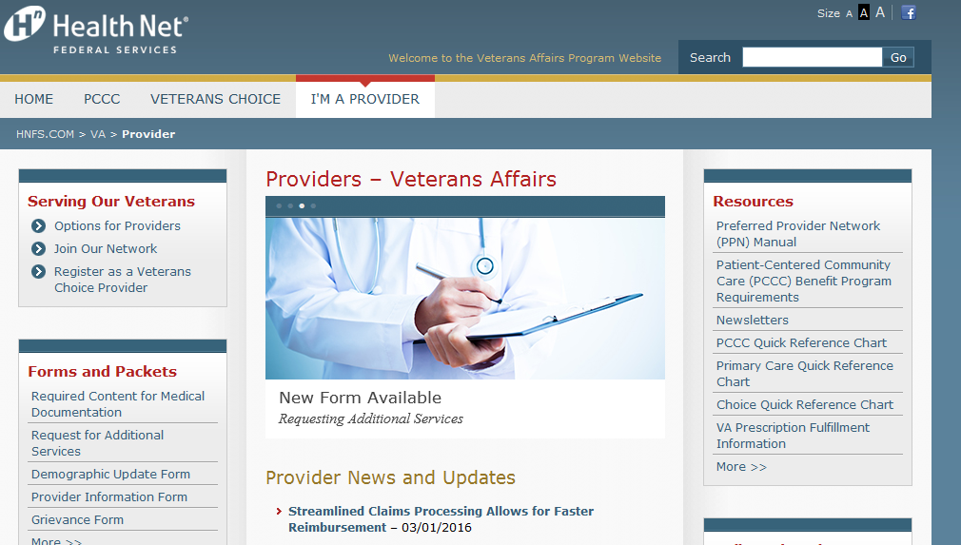
www.hnfs.com/go/VA
Please visit our website for the latest news and updates on VA programs at www.hnfs.com/go/VA.

Slide 30
Provider Resources
Be sure to view the following resources:
  PCCC Quick Reference Chart
  VCP Quick Reference Chart
  Provider Forms and Packets
  VA Prescription Fulfillment Information
  … and more.

Slide 31
Important Contact Numbers
Veterans Choice Call Center
1-866-606-8198
Monday through Friday, 9:00 a.m.–5:00 p.m. Eastern time, excluding certain holidays
Patient-Centered Community Care Call Center
1-800-979-9620
Monday through Friday, 6:00 a.m.–10:00 p.m. Eastern time, excluding certain holidays
Medical documentation, both programs:
Fax: 1-855-300-1705

Slide 32
Thank you for serving our nation's Veterans!

